Slide 1
Behavioral Design Pattern
Instructor: Mehroze Khan

Slide 2
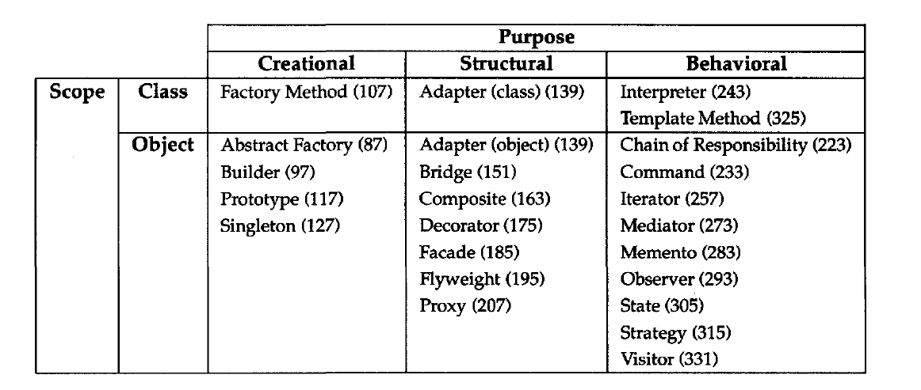
Behavioral Design Pattern
Behavioral design patterns are concerned with algorithms and the assignment of responsibilities between objects.
Behavioral patterns describe not just patterns of objects or classes but also the patterns of communication between them.

Slide 3
Observer Pattern

Slide 4
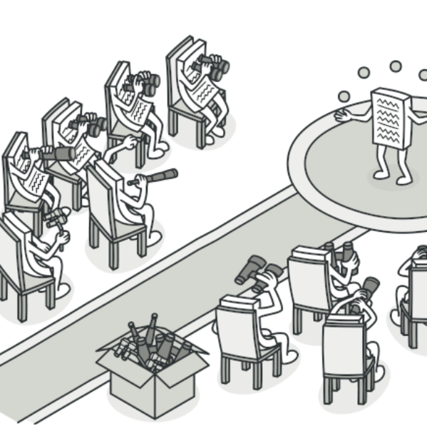
Observer Pattern
Also Known as: Event-Subscriber, Listener
Intent:
Observer is a behavioral design pattern that lets you define a subscription mechanism to notify multiple objects about any events that happen to the object they’re observing.

Slide 5
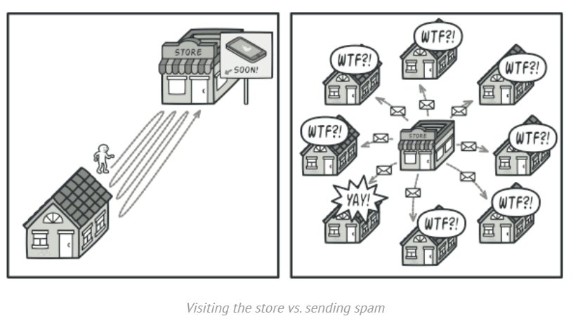
Problem
Imagine that you have two types of objects: a Customer and a Store.
The customer is very interested in a particular brand of product (say, it’s a new model of the iPhone) which should become available in the store very soon.
The customer could visit the store every day and check product availability. But while the product is still enroute, most of these trips would be pointless.

Slide 6
Problem
On the other hand, the store could send tons of emails (which might be considered spam) to all customers each time a new product becomes available.
This would save some customers from endless trips to the store. At the same time, it’d upset other customers who aren’t interested in new products.
It looks like we’ve got a conflict. Either the customer wastes time checking product availability or the store wastes resources notifying the wrong customers.

Slide 7
Solution
The object that has some interesting state is often called subject, but since it’s also going to notify other objects about the changes to its state, we’ll call it publisher.
All other objects that want to track changes to the publisher’s state are called subscribers.

Slide 8
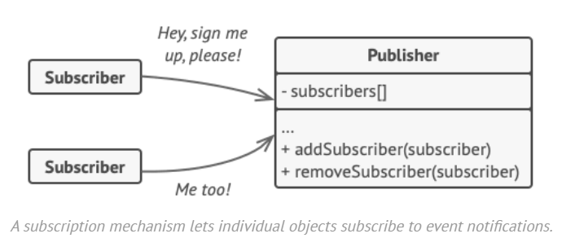
Solution
The Observer pattern suggests that you add a subscription mechanism to the publisher class so individual objects can subscribe to or unsubscribe from a stream of events coming from that publisher.
This mechanism consists of:
1) an array field for storing a list of references to subscriber objects
2) several public methods which allow adding subscribers to and removing them from that list.

Slide 9
Solution
Now, whenever an important event happens to the publisher, it goes over its subscribers and calls the specific notification method on their objects.
Real apps might have dozens of different subscriber classes that are interested in tracking events of the same publisher class.
You wouldn’t want to couple the publisher to all those classes. Besides, you might not even know about some of them beforehand if your publisher class is supposed to be used by other people.

Slide 10
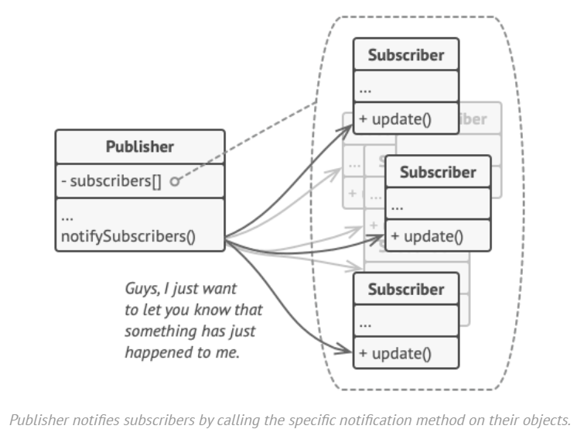
Solution
That’s why it’s crucial that all subscribers implement the same interface and that the publisher communicates with them only via that interface.
This interface should declare the notification method along with a set of parameters that the publisher can use to pass some contextual data along with the notification.
If your app has several different types of publishers and you want to make your subscribers compatible with all of them, you can go even further and make all publishers follow the same interface. This interface would only need to describe a few subscription methods. The interface would allow subscribers to observe publishers’ states without coupling to their concrete classes.

Slide 11
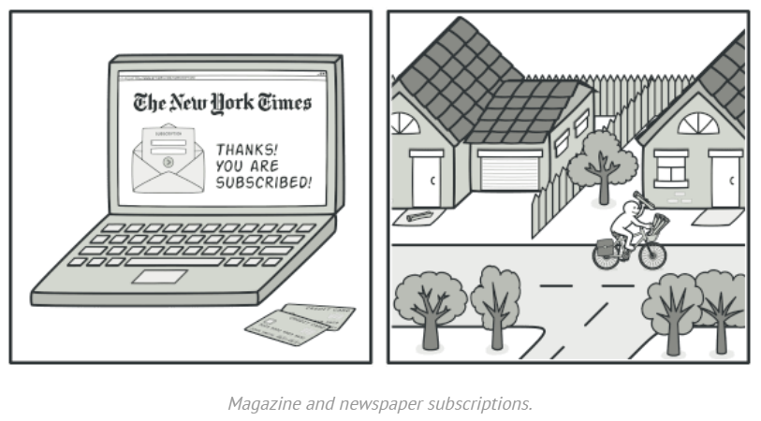
Real World Analogy
If you subscribe to a newspaper or magazine, you no longer need to go to the store to check if the next issue is available. Instead, the publisher sends new issues directly to your mailbox right after publication or even in advance.
The publisher maintains a list of subscribers and knows which magazines they’re interested in. Subscribers can leave the list at any time when they wish to stop the publisher sending new magazine issues to them.

Slide 12
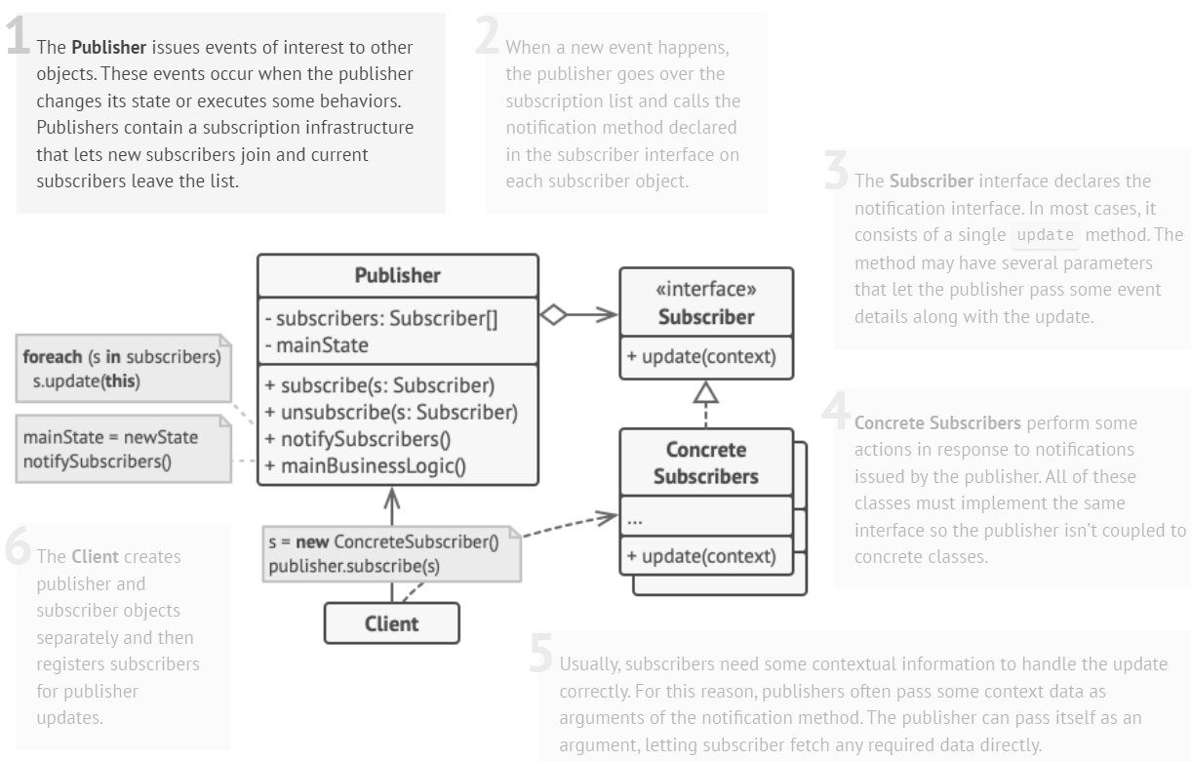
Structure

Slide 13
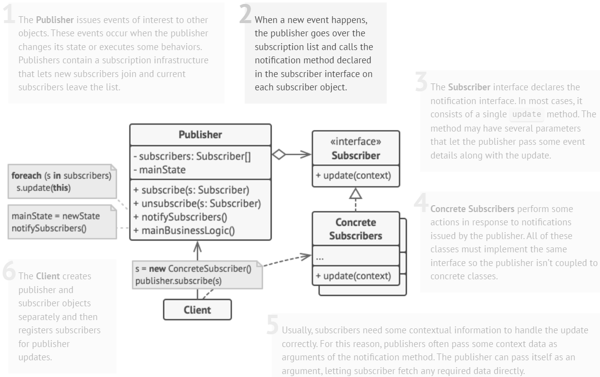
Structure

Slide 14
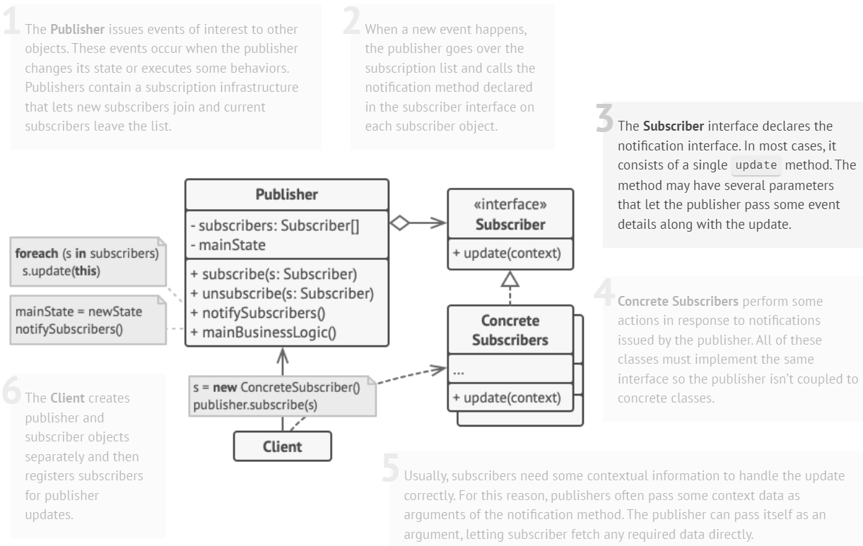
Structure

Slide 15
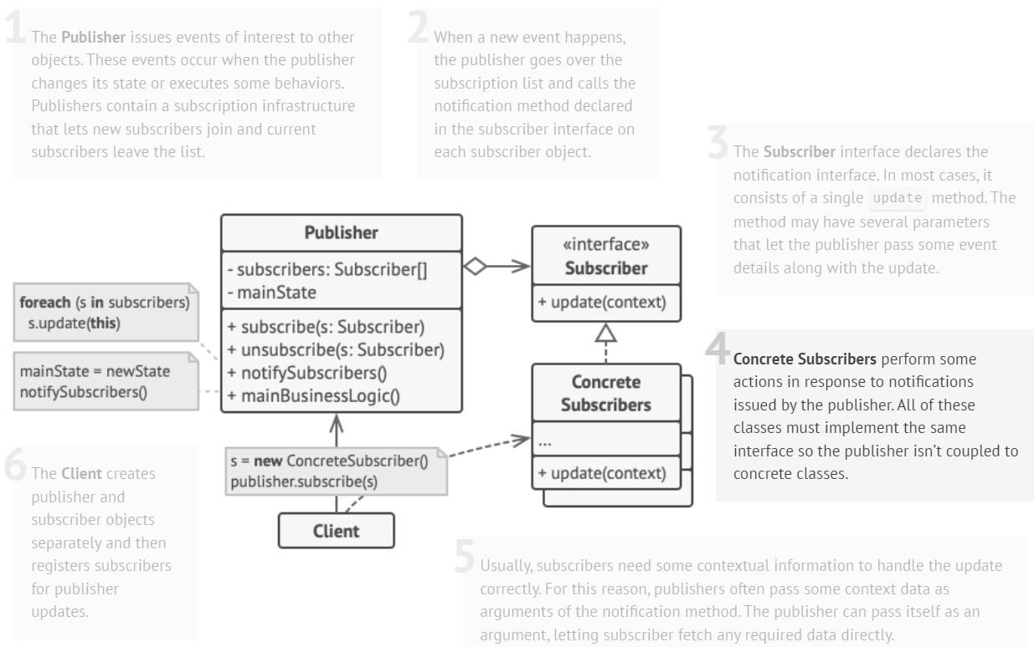
Structure

Slide 16
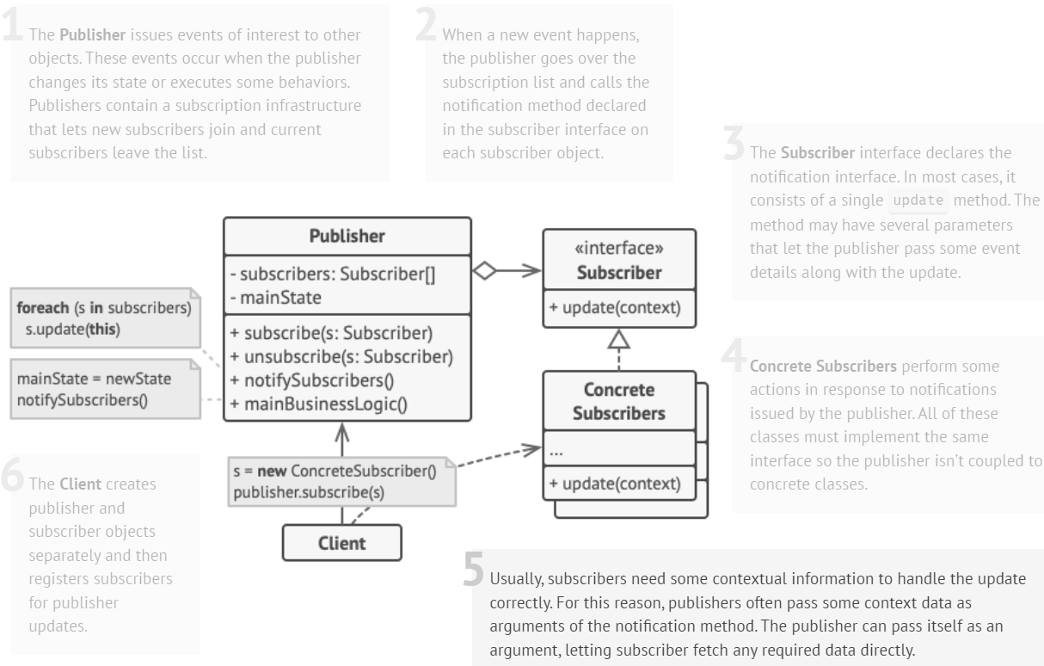
Structure

Slide 17
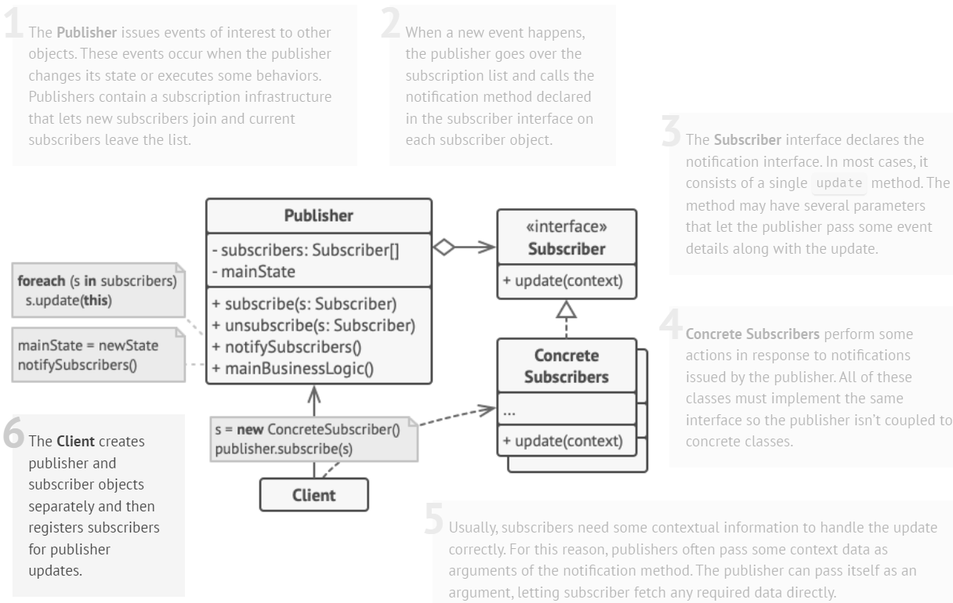
Structure

Slide 18
Example
// Abstract Subscriber class
class Subscriber {
public:
virtual void update(const string& message) = 0;
};
// Concrete Subscriber class
class ConcreteSubscriber : public Subscriber {
public:
void update(const string& message) override {
cout << "Received update: " << message << endl;
}
};
// Publisher class
class Publisher {
private:
list<Subscriber*> subscribers;
public:
void subscribe(Subscriber* subscriber) {
subscribers.push_back(subscriber);
}
void unsubscribe(Subscriber* subscriber) {
subscribers.remove(subscriber);
}
void notifySubscribers(const string& message) {
for (Subscriber* subscriber : subscribers) {
subscriber->update(message);
}
}
};

Slide 19
Example
// Client
int main() {
Publisher publisher;
ConcreteSubscriber subscriber1, subscriber2, subscriber3;
publisher.subscribe(&subscriber1);
publisher.subscribe(&subscriber2);
publisher.subscribe(&subscriber3);
publisher.notifySubscribers("Data updated!");
publisher.unsubscribe(&subscriber1);
publisher.notifySubscribers("Another update!");
return 0;
}
// Output
Received update: Data updated!
Received update: Data updated!
Received update: Data updated!
Received update: Another update!
Received update: Another update!

Slide 20
Pros and Cons
Pros:
Open/Closed Principle
You can introduce new subscriber classes without having to change the publisher’s code (and vice versa if there’s a publisher interface).
You can establish relations between objects at runtime.
Cons:
Subscribers are notified in random order.

Slide 21
Template Method Pattern

Slide 22
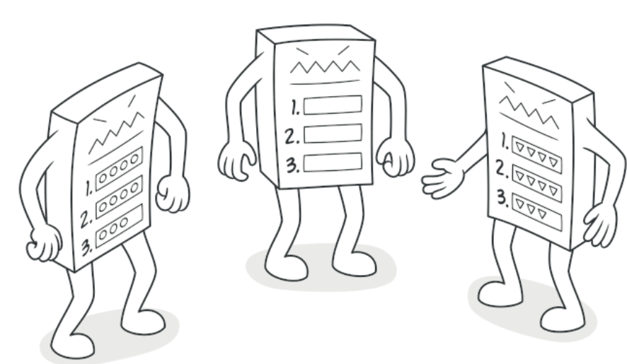
Template Method Pattern
Intent:
Template Method is a behavioral design pattern that defines the skeleton of an algorithm in the superclass but lets subclasses override specific steps of the algorithm without changing its structure.

Slide 23
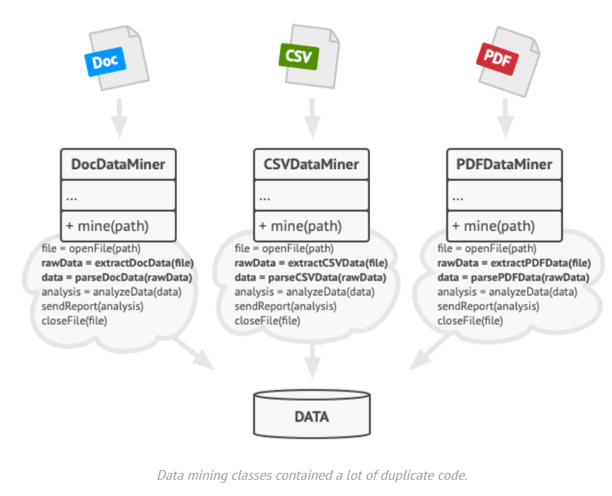
Problem
Imagine that you’re creating a data mining application that analyzes corporate documents. Users feed the app documents in various formats (PDF, DOC, CSV), and it tries to extract meaningful data from these docs in a uniform format.
The first version of the app could work only with DOC files. In the following version, it was able to support CSV files. A month later, you “taught” it to extract data from PDF files.

Slide 24
Problem
At some point, you noticed that all three classes have a lot of similar code.
While the code for dealing with various data formats was entirely different in all classes, the code for data processing and analysis is almost identical.
Wouldn’t it be great to get rid of the code duplication, leaving the algorithm structure intact?
There was another problem related to client code that used these classes. It had lots of conditionals that picked a proper course of action depending on the class of the processing object.
If all three processing classes had a common interface or a base class, you’d be able to eliminate the conditionals in client code and use polymorphism when calling methods on a processing object.

Slide 25
Solution
The Template Method pattern suggests that you break down an algorithm into a series of steps, turn these steps into methods, and put a series of calls to these methods inside a single template method.
The steps may either be abstract or have some default implementation.
To use the algorithm, the client is supposed to provide its own subclass, implement all abstract steps, and override some of the optional ones if needed (but not the template method itself).

Slide 26
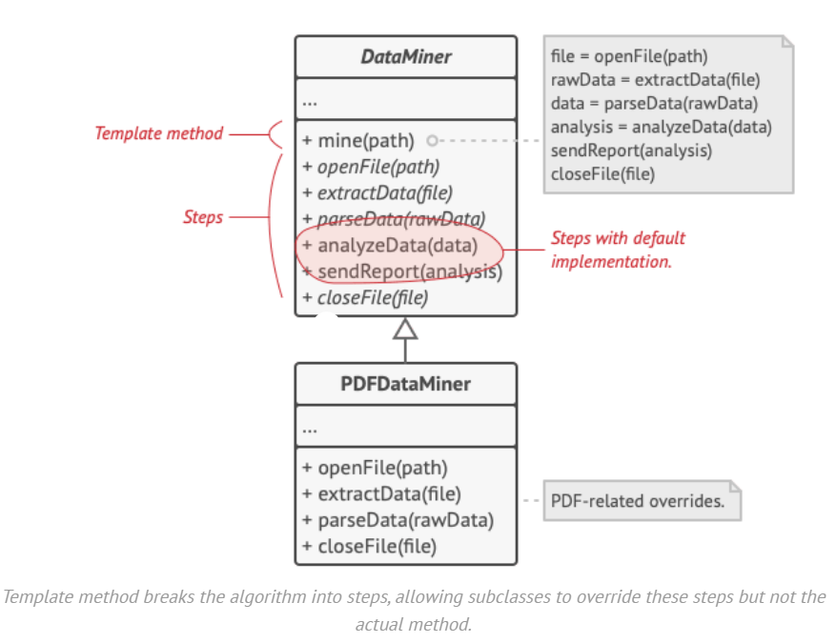
Solution
We can create a base class for all three parsing algorithms.
This class defines a template method consisting of a series of calls to various document-processing steps.

Slide 27
Solution
At first, we can declare all steps abstract, forcing the subclasses to provide their own implementations for these methods.
In our case, subclasses already have all necessary implementations, so the only thing we might need to do is adjust signatures of the methods to match the methods of the superclass.
Now, let’s see what we can do to get rid of the duplicate code. It looks like the code for opening/closing files and extracting/parsing data is different for various data formats, so there’s no point in touching those methods.
Implementation of other steps, such as analyzing the raw data and composing reports, is very similar, so it can be pulled up into the base class, where subclasses can share that code.

Slide 28
Solution
As you can see, we’ve got two types of steps:
Abstract steps must be implemented by every subclass
Optional steps already have some default implementation, but still can be overridden if needed
There’s another type of step, called hooks.
A hook is an optional step with an empty body. A template method would work even if a hook isn’t overridden.
Usually, hooks are placed before and after crucial steps of algorithms, providing subclasses with additional extension points for an algorithm.

Slide 29
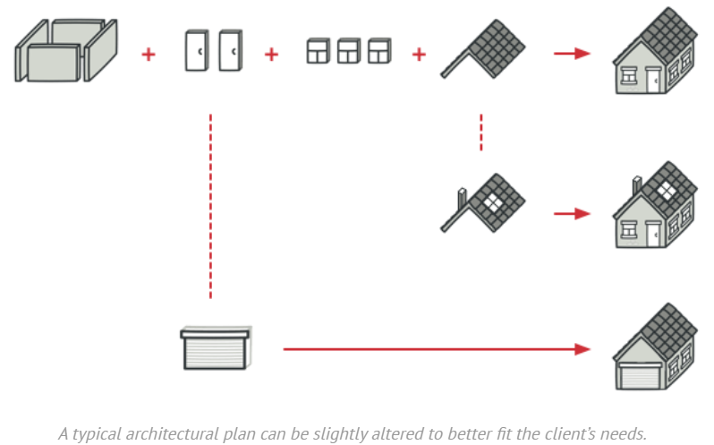
Real World Analogy
The template method approach can be used in mass housing construction. The architectural plan for building a standard house may contain several extension points that would let a potential owner adjust some details of the resulting house.
Each building step, such as laying the foundation, framing, building walls, installing plumbing and wiring for water and electricity, etc., can be slightly changed to make the resulting house a little bit different from others.

Slide 30
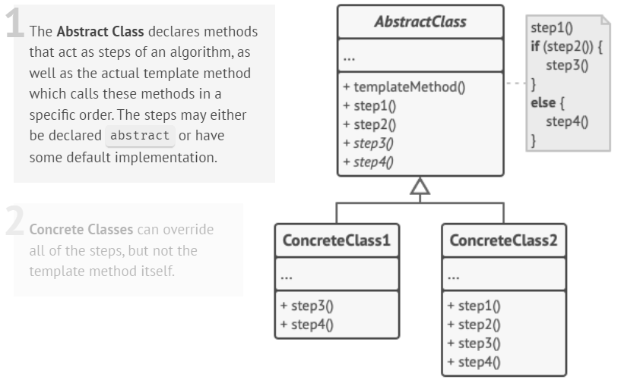
Structure

Slide 31
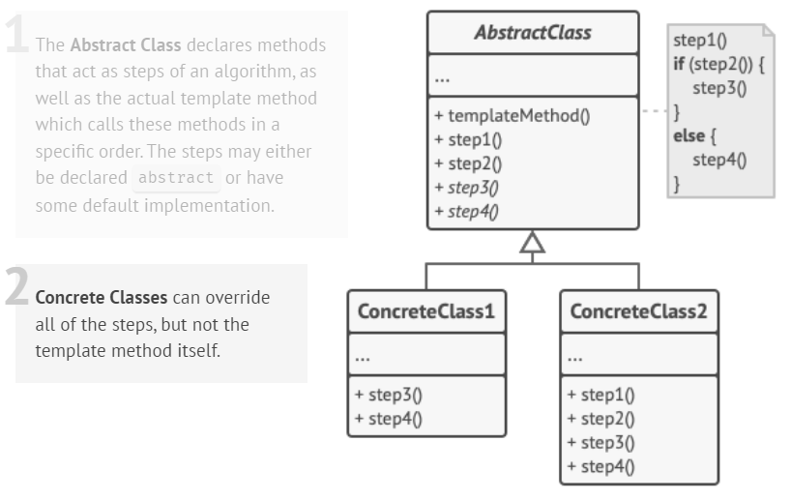
Structure

Slide 32
Example
// Abstract class defining the template method
class AbstractClass {
public:
// Template method defining the algorithm
void templateMethod() {
step1();
step2();
commonStep();
step3();
}
// Abstract methods to be implemented by subclasses
virtual void step1() = 0;
virtual void step3() = 0;
// Default implementation of step2
void step2() {
cout << "Default Step 2" << endl;
}
// Common step with a default implementation
virtual void commonStep() {
cout << "Common Step (Default implementation)" << endl;
}
};
// Concrete class implementing the AbstractClass
class ConcreteClass : public AbstractClass {
public:
void step1() override {
cout << "Custom Step 1" << endl;
}
void step3() override {
cout << "Custom Step 3" << endl;
}
// Overriding the commonStep method
void commonStep() override {
cout << "Custom Common Step" << endl;
} };

Slide 33
Example
int main() {
AbstractClass* object = new ConcreteClass();
// Calling the template method
object->templateMethod();
}
// Output
Custom Step 1
Default Step 2
Custom Common Step
Custom Step 3

Slide 34
Another Example
class AbstractClass {
public:
void TemplateMethod() const {
BaseOperation1();
RequiredOperations1();
BaseOperation2();
Hook1();
RequiredOperation2();
BaseOperation3();
Hook2();
}
protected:
void BaseOperation1() const {
cout << "AbstractClass says: I am doing the bulk of the work\n";
}
void BaseOperation2() const {
cout << "AbstractClass says: But I let subclasses override some operations\n"; }
void BaseOperation3() const {
cout << "AbstractClass says: But I am doing the bulk of the work anyway\n";
}
virtual void RequiredOperations1() const = 0;
virtual void RequiredOperation2() const = 0;
virtual void Hook1() const {}
virtual void Hook2() const {}
};
class ConcreteClass1 : public AbstractClass {
protected:
void RequiredOperations1() const override {
cout << "ConcreteClass1 says: Implemented Operation1\n";
}
void RequiredOperation2() const override {
cout << "ConcreteClass1 says: Implemented Operation2\n";
}
};

Slide 35
Another Example
class ConcreteClass2 : public AbstractClass {
protected:
void RequiredOperations1() const override {
cout << "ConcreteClass2 says: Implemented Operation1\n";
}
void RequiredOperation2() const override {
cout << "ConcreteClass2 says: Implemented Operation2\n";
}
void Hook1() const override {
cout << "ConcreteClass2 says: Overridden Hook1\n";
}
};
void ClientCode(AbstractClass* class_) {
class_->TemplateMethod();
}
int main() {
cout << "Same client code can work with different subclasses:\n";
ConcreteClass1* concreteClass1 = new ConcreteClass1;
ClientCode(concreteClass1);
cout << "\n";
cout << "Same client code can work with different subclasses:\n";
ConcreteClass2* concreteClass2 = new ConcreteClass2;
ClientCode(concreteClass2);
}

Slide 36
Another Example
int main() {
cout << "Same client code can work with different subclasses:\n";
ConcreteClass1* concreteClass1 = new ConcreteClass1;
ClientCode(concreteClass1);
cout << "\n";
cout << "Same client code can work with different subclasses:\n";
ConcreteClass2* concreteClass2 = new ConcreteClass2;
ClientCode(concreteClass2);
}
// Output:
Same client code can work with different subclasses:
AbstractClass says: I am doing the bulk of the work
ConcreteClass1 says: Implemented Operation1
AbstractClass says: But I let subclasses override some operations
ConcreteClass1 says: Implemented Operation2
AbstractClass says: But I am doing the bulk of the work anyway
Same client code can work with different subclasses:
AbstractClass says: I am doing the bulk of the work
ConcreteClass2 says: Implemented Operation1
AbstractClass says: But I let subclasses override some operations
ConcreteClass2 says: Overridden Hook1
ConcreteClass2 says: Implemented Operation2
AbstractClass says: But I am doing the bulk of the work anyway

Slide 37
References
Design Patterns: Elements of Reusable Object-Oriented Software, Erich Gamma, Richard Helm, Ralph Johnson, and John Vlissides, Pearson, 1995.
Helping Links:
https://refactoring.guru/design-patterns/

